Slide 1
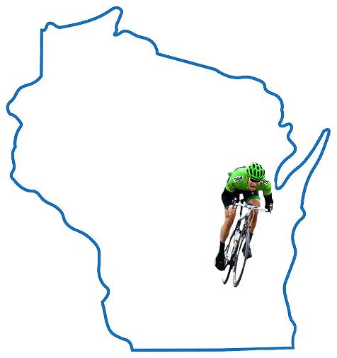

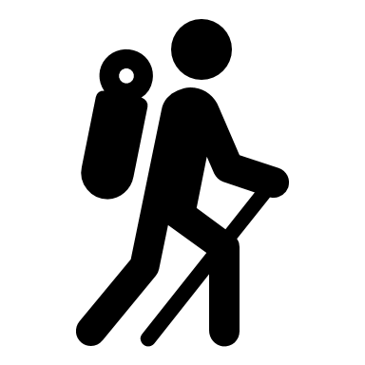
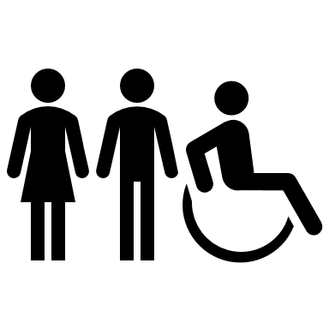

Wisconsin’s Fox Cities:
A Leader in Trails for Fun and
Low-Impact Transportation
Municipalities plan $24 million in
trail construction by 2025
Compiled by Community Foundation for the Fox Valley Region
June 2021

Slide 2

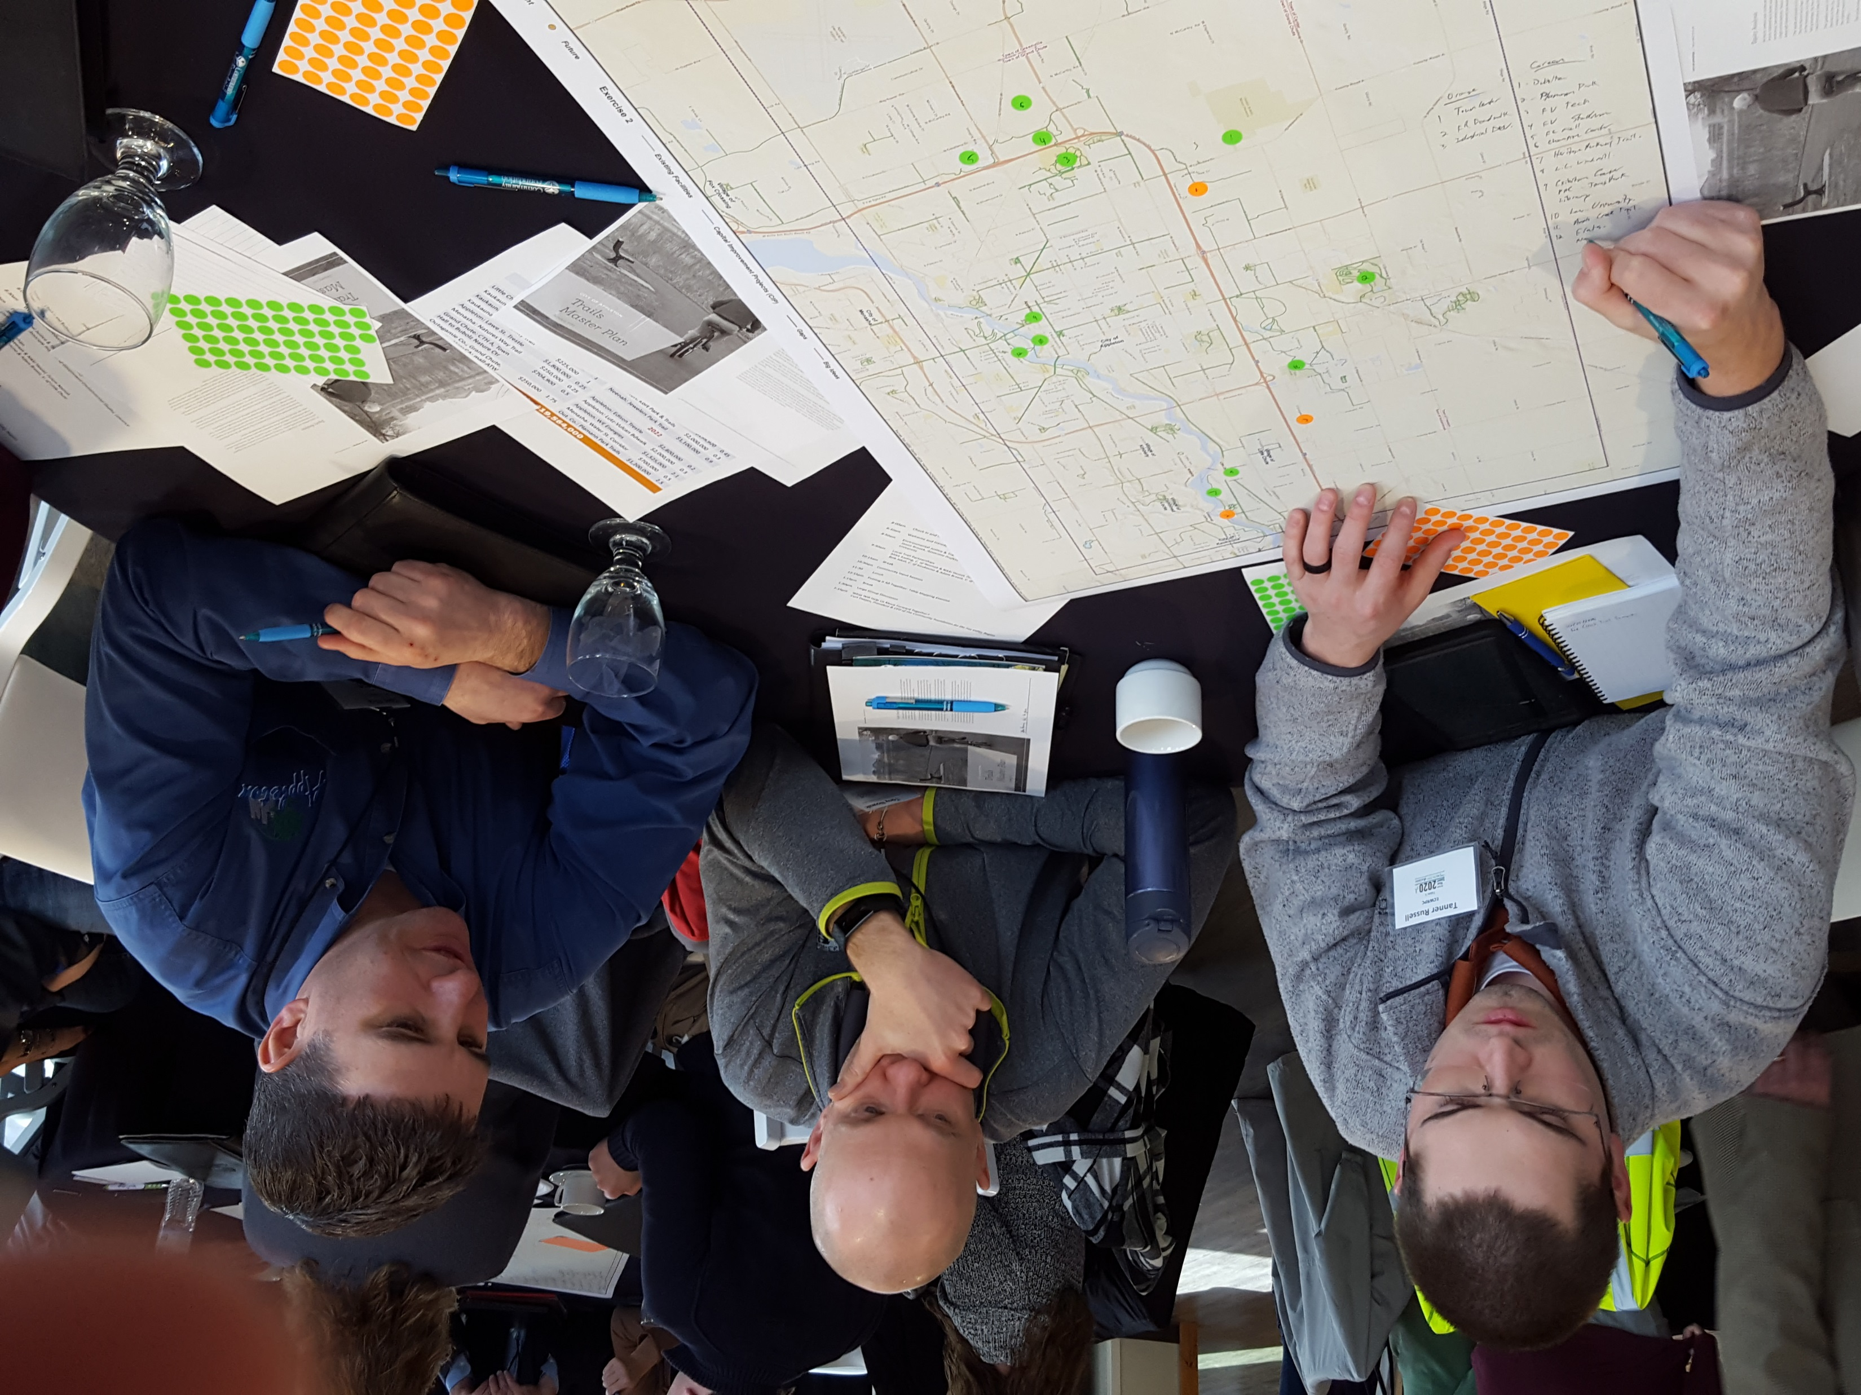
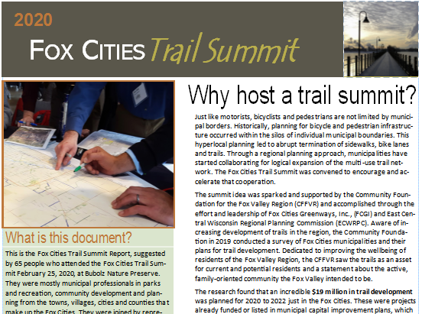
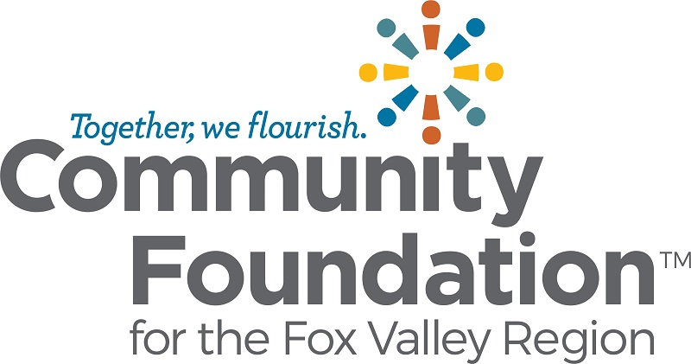
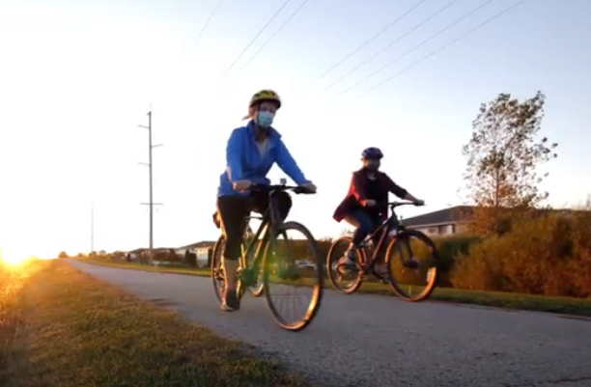
How We Got Here
FEB. 25, 2020: FOX CITIES TRAIL SUMMIT
Sponsored by Fox Cities Greenways, East Central Wisconsin Regional Planning Commission and Community Foundation for the Fox Valley Region at Bubolz Nature Preserve. Sixteen municipalities and nine organizations represented.
OCT. 27, 2020: TRAIL SUMMIT REPORT RELEASED
At virtual presentation by author and photographer Dudley Edmondson on the divide between outdoor activities and people of color. Top priorities were Fox Cities to High Cliff State Park, Neenah to Oshkosh and Kaukauna to Green Bay. Also premiered video of Loop the Locks Trail.
FALL OF 2020: COVID SENDS PEOPLE OUTDOORS
Fox Cities residents found the solution to going stir crazy from sheltering in place was to get out and walk the trails. Trail usage at least doubled in most places.

Slide 3

Trails built or planned for 2020-21
Lawe Street railroad trestle converted to trail use
Paved trail connects Fox River Mall to
Appleton International Airport
Kaukauna extends CE Trail making GB route closer
Nature’s Way Trail in Menasha eliminates dangerous crossing near Oneida Street and Hwy. 114
1,200-foot Nelson Family Heritage Crossing connects Little Chute and Kaukauna trail networks
Railroad bed converted to trail connecting Nelson Family Heritage Crossing to downtown Kaukauna

Slide 4
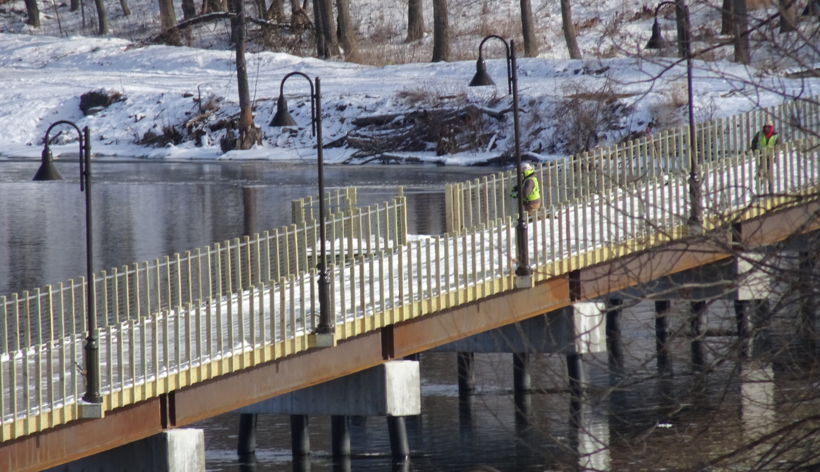
Little Chute-Kaukauna
Nelson Family Heritage Crossing
$3.96 million total project
$650,000 Nelson Fund challenge match started it
$1.1 million from Knowles-Nelson Stewardship Program
$600,000 Outagamie County’s Greenways Fund

Slide 5
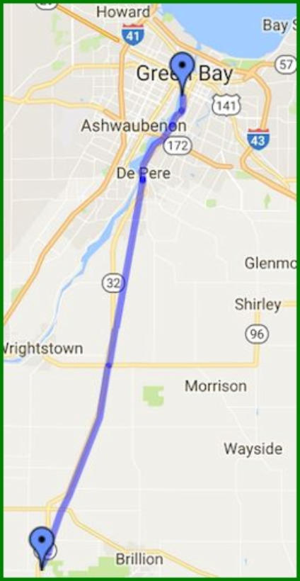
KAUKAUNA
$700,000
One-half mile added to CE Trail in 2020 creates a link to bicycle lanes on Hwys Z and ZZ, Fox River Trail and Green Bay.
Other pending
trail projects:
Railroad Trail,
2021, $150,000
Community Trail,
2021, $225,000
Fox River Trail

Slide 6
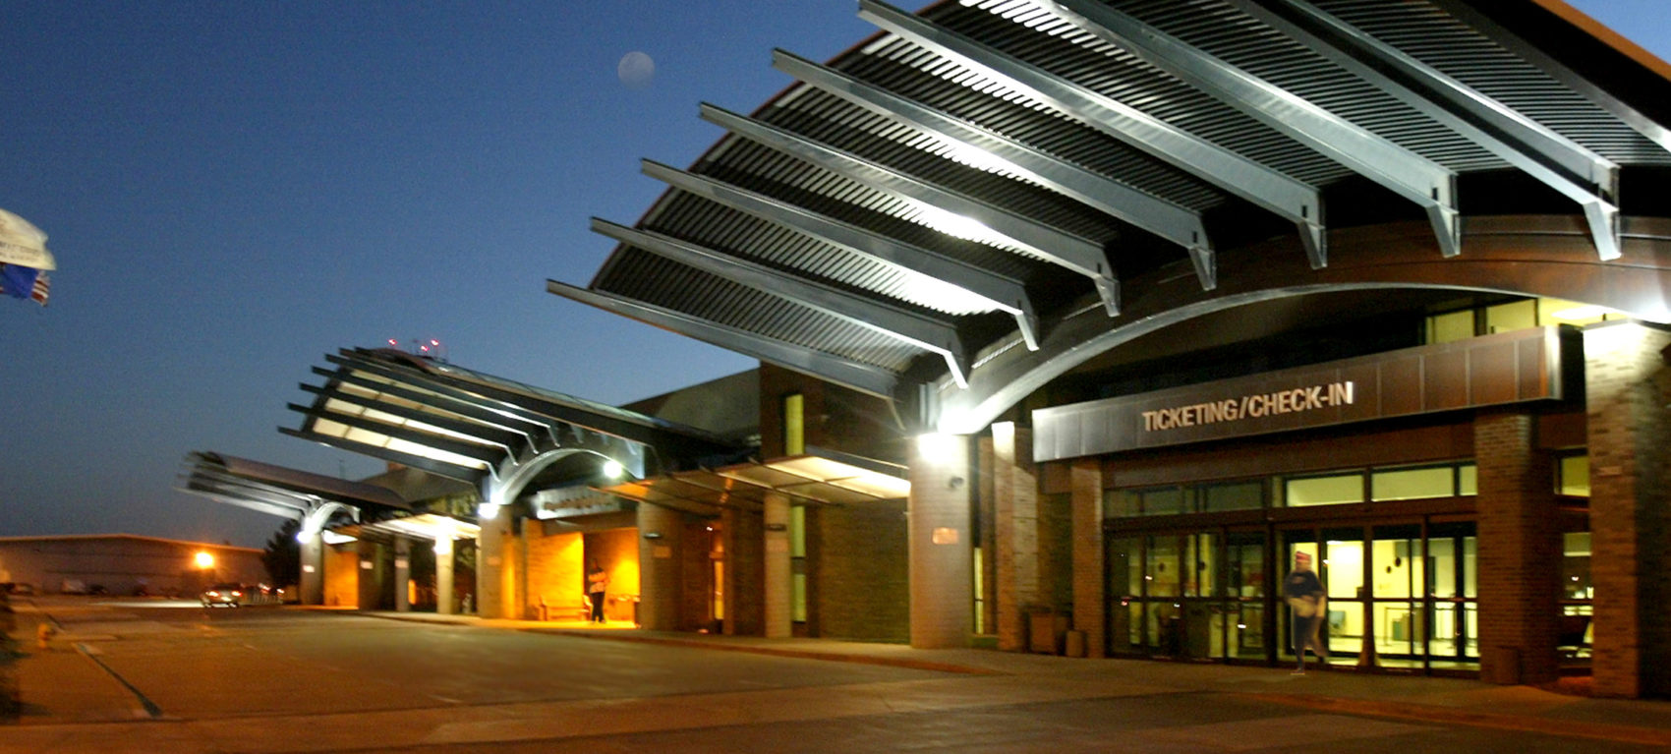
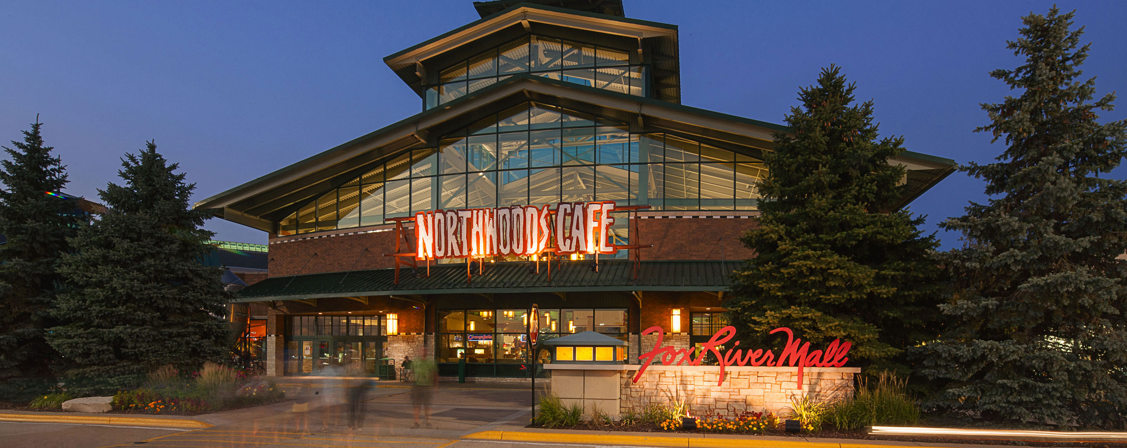
Outagamie County
Grand Chute, Greenville
Fox River Mall to ATW
$250,000 trail cost included in 2020 rebuild of W. College Ave.
Other Projects:
County A Trail: Connects Town Hall to Bubolz Nature Preserve.
Evergreen Drive Trail: Grand Chute, $132,000, links Town Hall to Meijer retail area in 2021

Slide 7
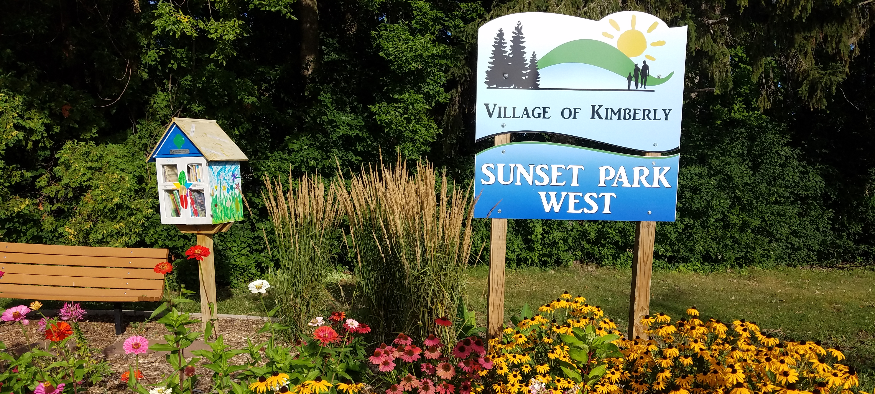
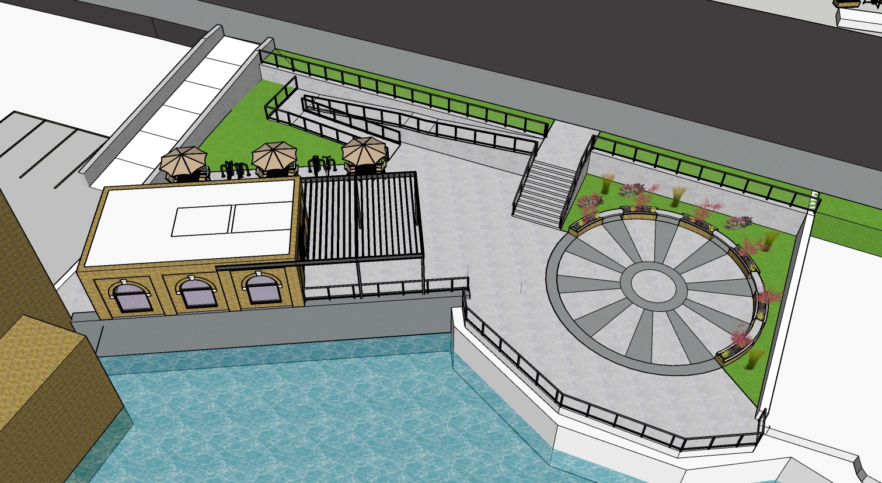
KIMBERLY
2021
Railroad Street Trail connects Kimberly riverfront to CE Trail.
$219,000
$100,000 Community Foundation fund
$10,000 Outagamie Co. Greenways
$10,000 Convention & Visitor Bureau
$10,000 Fox Cities Greenways Inc.
$5,000 Fox Communities C.U.
$84,000 Village of Kimberly
Other projects:
Treaty Park
Finished 2019
$1 million
Kimberly will build a restroom and resting area on the Papermill Trail in 2021

Slide 8
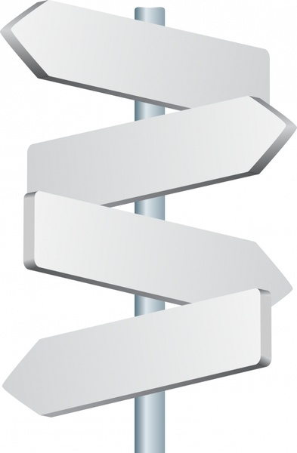
Appleton
Lawe Street Trestle l 2020 l $1.4 million
Connects Lawe Street and North Island Trail to Lawrence University, Eagle Point Senior Complex, Newberry Trail and John Street.
David and Rita Nelson Heritage Bridge
2022 l $2.8 million ($500,000 Nelson Fund, $300,000 Outagamie County Greenways). Connects future Ellen Kort Peace Park with Jones Park, Rocky Bleier Trail, Lutz Park, future Lutz-Vulcan Heritage Trail and Boardwalk, North Island Trail and Newberry Trail.
Lutz-Vulcan Boardwalk l 2025 l $2 million
Runs along north bank of Fox River connecting Lutz and Alicia parks to North Island Trail and Newberry Trail, and future Ellen Kort Peace Park and Nelson Bridge.
Nelson Heritage Bridge
Lawe St. Trestle
Peace Park
Boardwalk to
Lutz Park

Slide 9

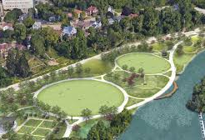
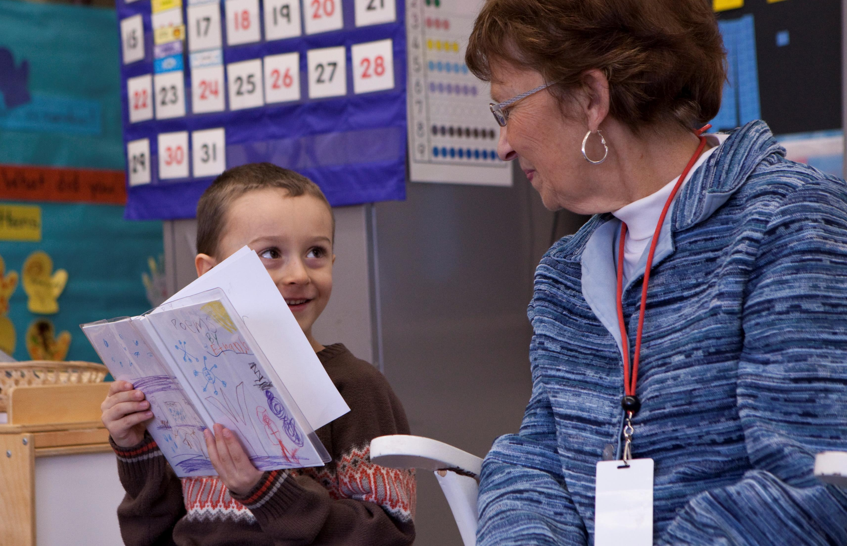
Ellen Kort Peace Park and River Trail
Appleton, $2 million
2022 Phase I (grading, exterior trail, lighting) $750,000 (Outagamie County Greenways $50,000) 2024 phase 2 (shelter, parking, landscaping, interior trails, gardens)

Slide 10
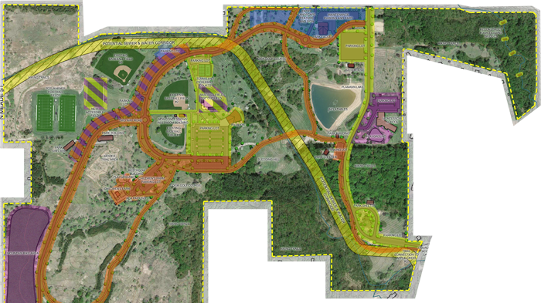
Outagamie County
Plamann Park Trails
$1.2 million

Slide 11
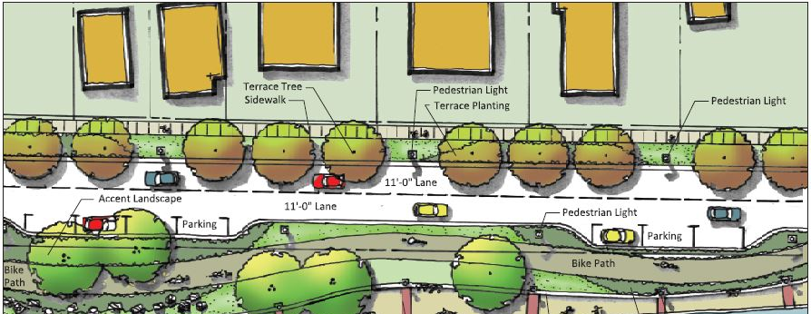
Menasha 2022: Water St. Corridor Trail
.
Nature’s Way Trail extension done: $250,000
Will connect downtown Menasha with the Friendship Trail Trestle by navigation canal.
$350,000

Slide 12
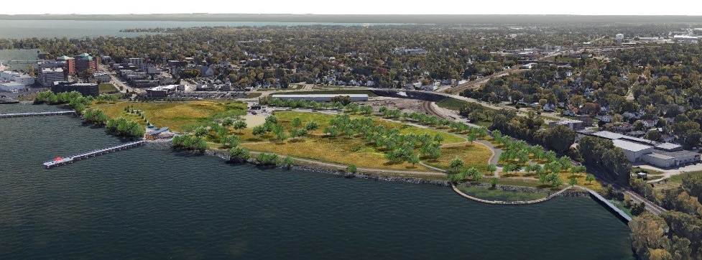
Neenah
Arrowhead Park
Up to $2M in trails
by 2024
Other Projects: Jeweler’s Park Trail
$1.1 million
Connects Bridgewood Trail to Breezewood

Slide 13

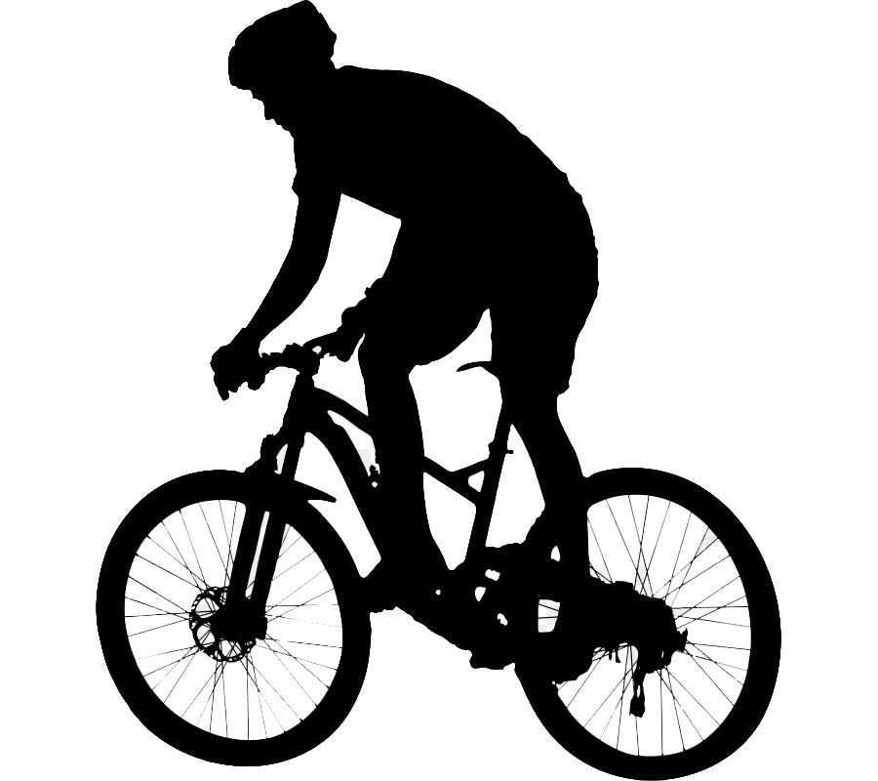
Fox Cities Trail Plans
Updated June 2021
2020
Lawe Street Trestle | Refurbished railroad trestle connecting Lawrence University at Lawe Street to Eagle Point senior living. | Appleton | $1,400,000
W. College Ave | Connects Fox River Mall to Appleton International Airport with an asphalt trail on W. College (CTH CE) | Grand Chute | $250,000
County A Trail | Trail from Town Hall west to Bubolz Nature Preserve along CTH A. | Grand Chute | $704,900
2021
Nelson Family Heritage Crossing | A new pedestrian and bicycle bridge over the Fox River linking the trail networks of Little Chute and Kaukauna. | Little Chute/ Kaukauna | $3,960,000
Kaukauna Railroad Trail | Former rail line along the bank of the Fox River that connects Nelson Family Crossing to downtown. | Kaukauna | $150,000
Kaukauna Community Trail | Ties Parkway Plaza on Crooks to city trail system. | Kaukauna | $225,000
Lawrence University Riverside Trail | Paved and lighted trail along the Fox River from Lawe Street across Drew Street to an observation deck with the public welcome. | Appleton (Lawrence campus) | $1,099,440
Nature’s Way Trail | A short but important connection to the Province Way Trail reaching north all the way to Midway Road and the Menasha Conservancy area. | Menasha | $250,000
Jewelers Park Trail | Connects Bridgewood Trail to the Cecil Street roundabout and Harrison Street | Neenah | $1,100,000
Winneconne Avenue Trail | Part of the reconstruction of E. Winneconne Ave., a paved trail will connect with the Walnut Street Trail, which leads to Shattuck Park. | Neenah | $25,000
Lakeshore Ave. Trail | A trail will be added from E. Wisconsin Ave. to Kimberly Point Park, a critical piece in creating a loop to Kimberly Point. | Neenah | $120,000
Evergreen Road Trail | Paved 10-foot-wide trail connects Grand Chute Town Hall with a new commercial area including a Meijer grocery store via the north side of Evergreen Drive, Towne Lakes Avenue and Orion Drive | Grand Chute | $132,000
Railroad Street Trail | Connects Kimberly’s riverfront with the CE Trail. Support includes $100,000 grant from a CFFVR donor fund. | Kimberly | $219,000

Slide 14
Total planned trail investment 2020-2025 is $24,147,890
Newton Blackmore Trail | Repurposed federal Community Development Block Grant money extends trail from House Road to Pfeiffer Park, downtown New London. | Outagamie County | $800,000
2022
David and Rita Nelson Heritage Bridge | A new pedestrian/bicycle bridge over the Fox River linking future Ellen Kort Peace Park, North Island Trail and Newberry Trail. Includes $500,000 Nelson Fund grant and $300,000 Outagamie County Greenways grant. | Appleton | $2,800,000
North Woodland Hills Trail | Connects existing trail from Gosling Way to Menasha city limits. | Menasha | $414,000
Conservation North Trail | Connection from Nature’s Way Trail to Woodland Hills Drive. Allows safe bike/ped travel to Kernan Ave and the Woodland Hills subdivision. | Menasha | $765,000
Gilbert Trail extension | Waterfront to Washington St./Garfield Ave. Creates downtown walking loop when combined with Lawson Canal and Racine St. bridge projects.Will connect Garfield Ave. to Loop the Lake. | Menasha | $400,000
Kimberly Point Park Trail | A loop taking trail users from Wisconsin Ave., around Kimberly Point Park and back to Wisconsin Ave. | Neenah | $200,000
Plamann Park | Reconfiguring of roads and trails in Outagamie County’s largest park. | Outagamie County | $1,200,000
Ellen Kort Peace Park | Connecting trails to Nelson Heritage Bridge, North Island Trials and Newberry Trail. Interior trails 2024. | Appleton | $750,000
2023
Water Street Trail | Redevelopment of a section of riverfront now dominated by boat storage. Connects Trestle Trail to Loop the Lake. | Menasha | $1,012,550
2024
Arrowhead Park | Trail construction will be ongoing in the new park 2021-25. | Neenah | $1.5 million to $2 million
Lawson Canal Trail | A redevelopment of the former Banta Corp. property to include a whitewater course and riverfront trail. | Menasha | $800,000
WE Energies Trail | Uses the power company’s right-of-way under transmission lines from Oneida Street to Plank Road. State DOT and TAP grants total $516,000. | Appleton | $1,525,000
2025
Lutz-Vulcan Board Walk | A boardwalk from Vulcan Park to the Appleton Yacht Club and Lutz Park suspended over the water. | Appleton | $2,000,000
Garfield Avenue Trail | Street reconstruction includes off-street bike/ped trail that connects Gilbert Trail to Lawson Trail and connects to Loop the Lake. | Menasha | Cost TBD

Slide 15
Thank You
Kim Biedermann Adam Breest Holly Femal Tom Flick Amanda Geiser Kara Homan Bob Jakel & Mike Sundelious Mike Kading Brian Tungate & Megan Sackett PowerPoint by David Horst | East Central Wis. Regional Planning Commission Village of Little Chute Village of Kimberly City of Appleton Village of Fox Crossing Outagamie County City of Kaukauna City of Neenah City of Menasha Community Foundation for the Fox Valley Region

